Slide 1
The Future of Space
Jason Bell – Jason Gilmore – Joyce Jones
Zachary Peck – Brittany Zembower

Slide 2
WHERE HAVE WE BEEN
SpaceX
Dec 21, 2015 - First attempt to land 1st stage of Falcon 9
ISS
Apr 2001 - Dennis Tito becomes the first Space Tourist to visit
Apollo 11
Jul 20, 1969 - Humanity sets foot on the moon
Sputnik 1
Oct 4, 1957 - First major milestone of the Space Race as the Soviet Union launches on

Slide 3
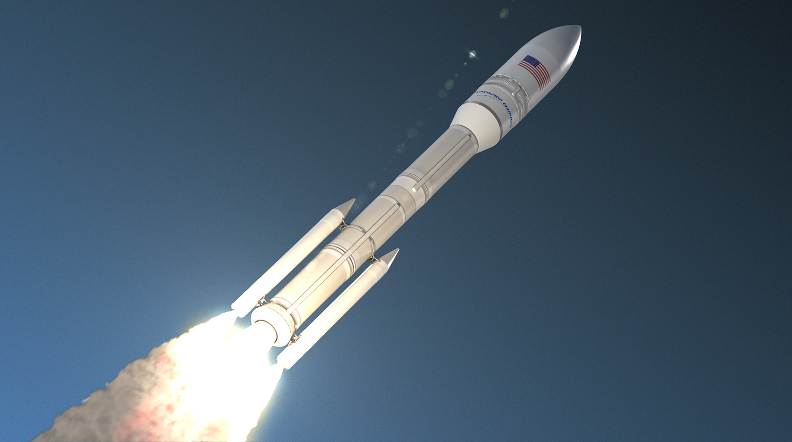
99%
$738B
Reusable Rockets
Space Force
Lowers costs of going into space:
-NASA Space Shuttle: $54,500/kg
-SpaceX Falcon 9: $2,720/kg
-Space Warfare resulting from national powers to secure space resources. -Current threats from Russia/China.
Probable,
Plausible,
Possible
Space Tourism
Space Mining
-Dennis Tito
-Virgin Galactic, Blue Origin, SpaceX
-Balloon tourism
-Trump Executive Order
-Increasing Wealth Gap
-First Trillionaire in the
world will mine
asteroids
-Luxembourg Space
Resource Initiative
$250K
6 Apr
Notes:
99%- If Musk can really deliver a $2 million space ride, it would be dramatically cheaper than the $152 million the average NASA space launch costs, according to data obtained by Futurism and earlier reported on by CNET. In fact, if Musk is right, his space travel could cost just a little over 1 percent of what NASA pays to go to space. (https://www.inc.com/don-reisinger/elon-musk-says-he-can-cut-99-off-price-of-space-travel-heres-how.html)
Between 1970 and 2000, the cost to launch a kilogram to space remained fairly steady, with an average of US$18,500 per kilogram. When the space shuttle was in operation, it could launch a payload of 27,500 kilograms for $1.5 billion, or $54,500 per kilogram. For a SpaceX Falcon 9, the rocket used to access the ISS, the cost is just $2,720 per kilogram. (https://theconversation.com/how-spacex-lowered-costs-and-reduced-barriers-to-space-112586)
Space Tourism
Dennis Tito was the first private citizen that paid for a trip to ISS, costing him $20 Million
Compare that to the current cost to reserve a seat on a Virgin Galactic flight of $250 K
This cost will likely only keep falling with the increased competition between Virgin, Blue Origin, and SpaceX
Even just days ago, Space Perspective announced plans for test flights of a space balloon, which would further drive down the costs
Space Force
Current accelerations in international communities to build Space Warfare - US announces intention to create Space Force on 14 January (738 Billion Defense Spending Bill)
India recently shot down one of its own satellites on March 27, 2019
Trump Executive Order- “Encouraging International Support for the Recovery and Use of Space Resources,”

Slide 4
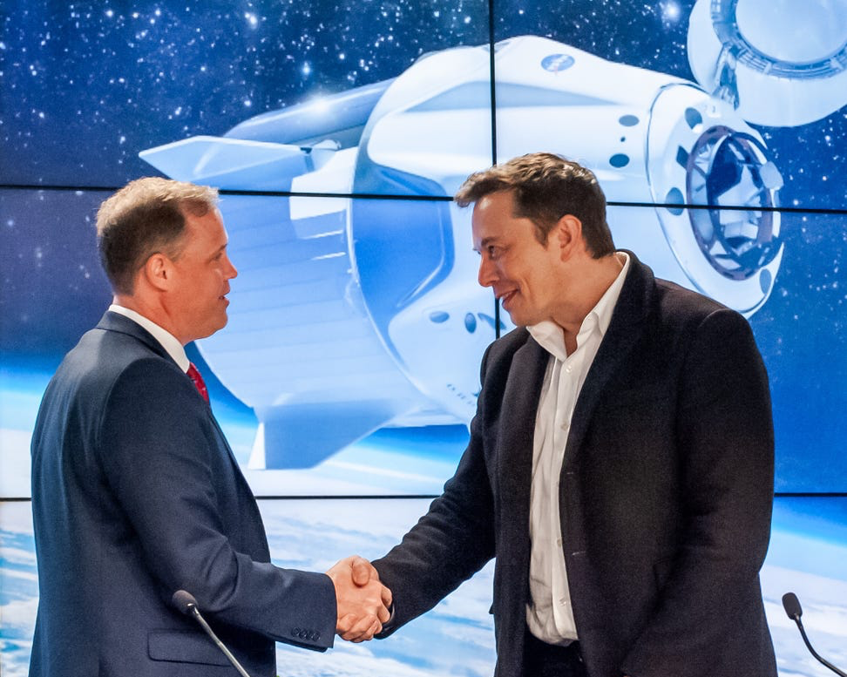
A10 | Friday June 20, 2040
THE WALL STREET JOURNAL
WORLD NEWS
International Community Bans All Resource Extraction & Production on Planet Earth, Says the Future is in Space
By The Space Group
Transportation to space has become exponentially cheaper due to advancements in Space Tourism over the last 20 years. Space organizations and entities around the globe make landmark agreement to collaborate on the future of space. Cost efficiencies have made it more efficient to obtain precious metals from beyond planet Earth. Technological advancements have made it safer and easier to transport humans to other planets, opening up space mining for future generations. This agreement signals the beginning of private involvement and international collaboration on a galactic scale.

Slide 5
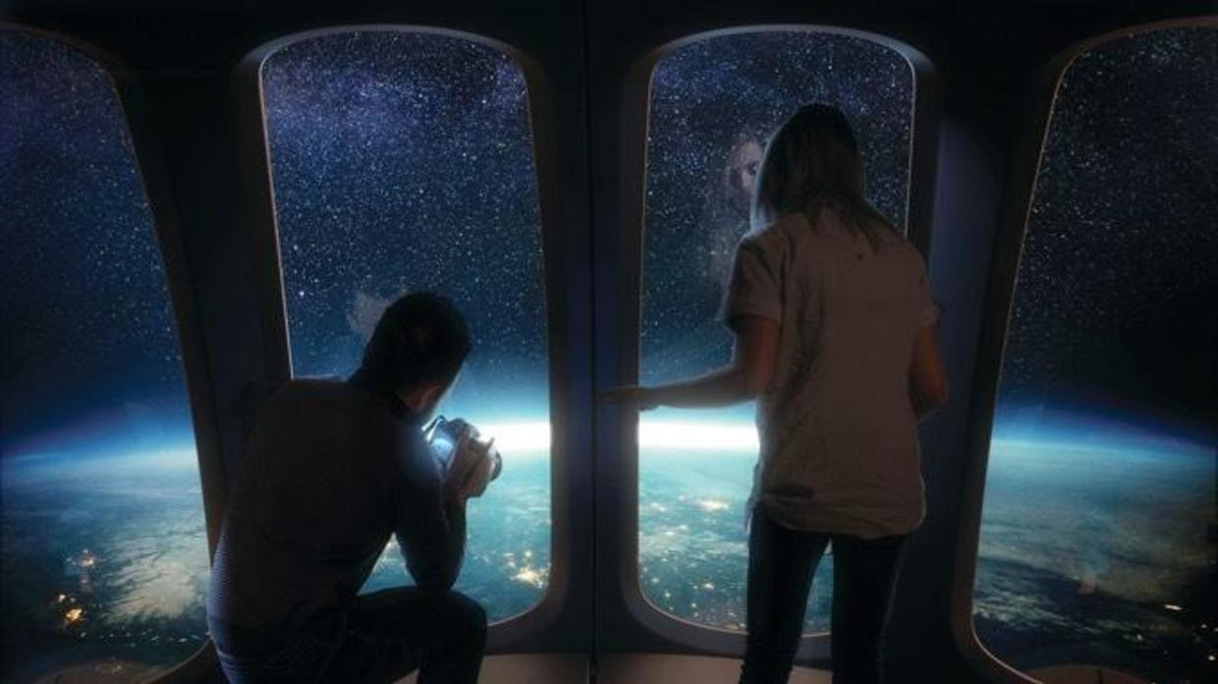
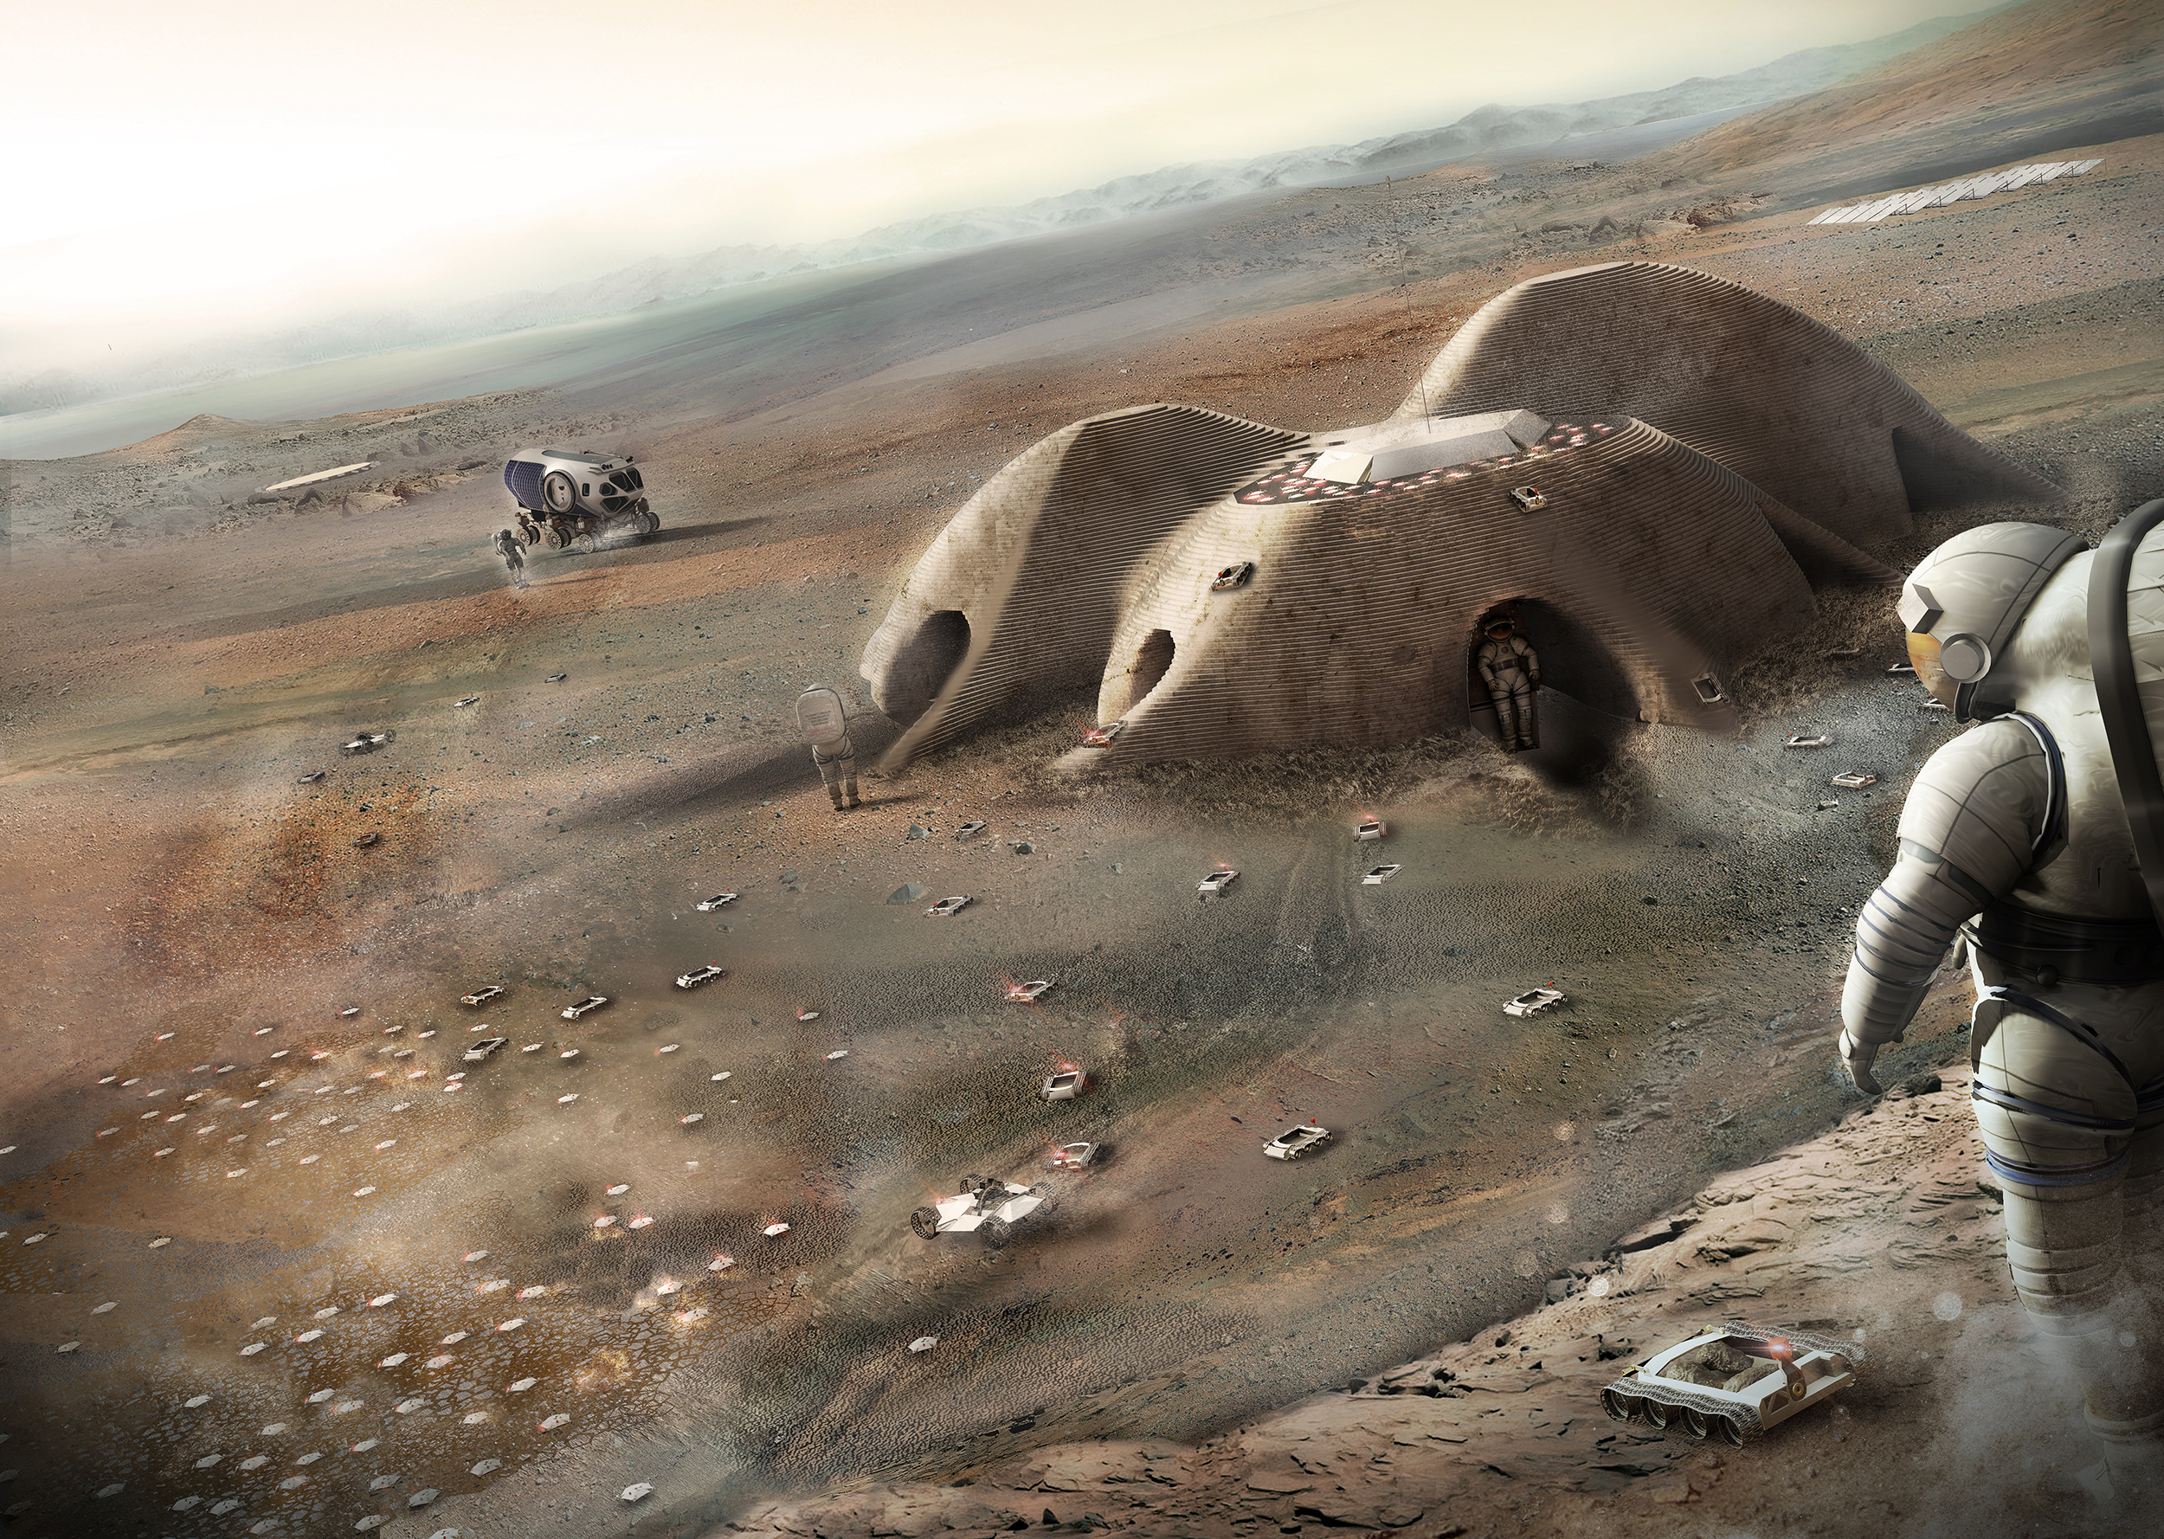
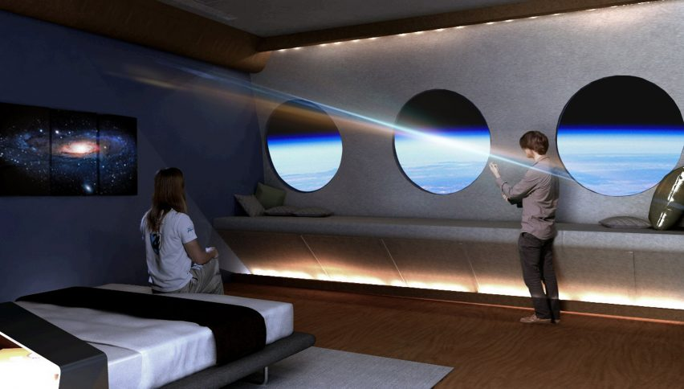
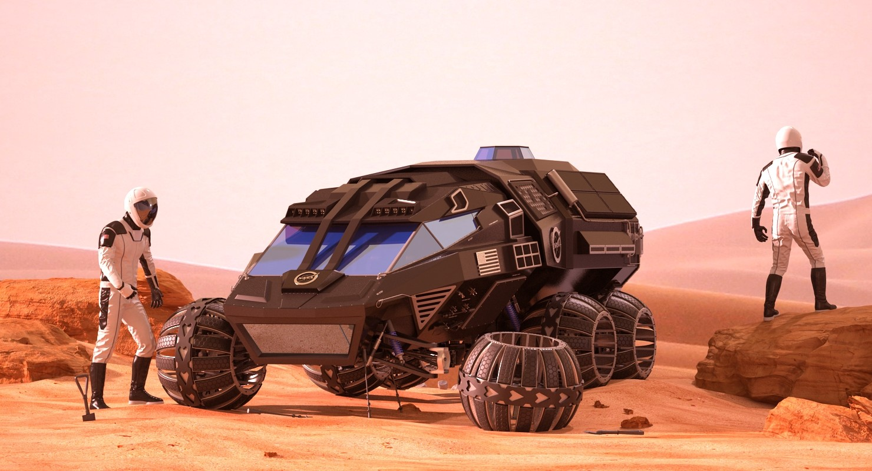
INCREASED ACCESSIBILITY FOR SCIENCE AND TOURISM
Notes:
Reusable rockets and reduced cost of access to space could lead to greater accessibility and the advancement of technology enabling things like colonization and tourism.
Small satellites such as CubeSat, MicroSat-R, or Starlink can cost as low as $2.25M and bring Earth observation technology to smaller companies and accelerate innovation.
Changes in technology along with improvement in data processing and analysis could enable the real-time tracking on earth of Earth.
Instead of using customer data, Google could now directly monitor every car on the road. This would allow for completely autonomous cars that communicate with one another in real time while traveling down freeways at high speeds.
Accessible monitoring would then feed other areas of study and could be used to benefit global warming research, agricultural yields, weather models, or provide real-time traffic information.
seven tourists have visited the International Space Station (ISS)
Companies like Virgin Galactic focusing primarily on space tourism, and suborbital flights, the number of people who experience zero-gravity space flight will increase.
Society's fascination with astronauts and space will certainly increase along with the increased access leading to a greater desire to explore and travel further.
Space tourists will drive companies to invest in new man-made floating or orbiting city arrangements.

Slide 6
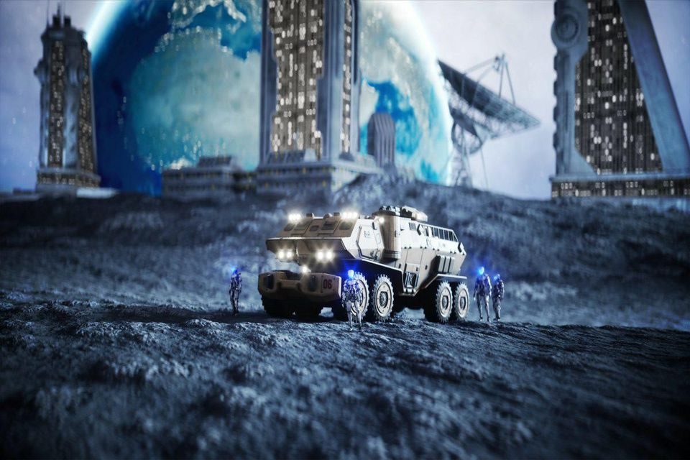
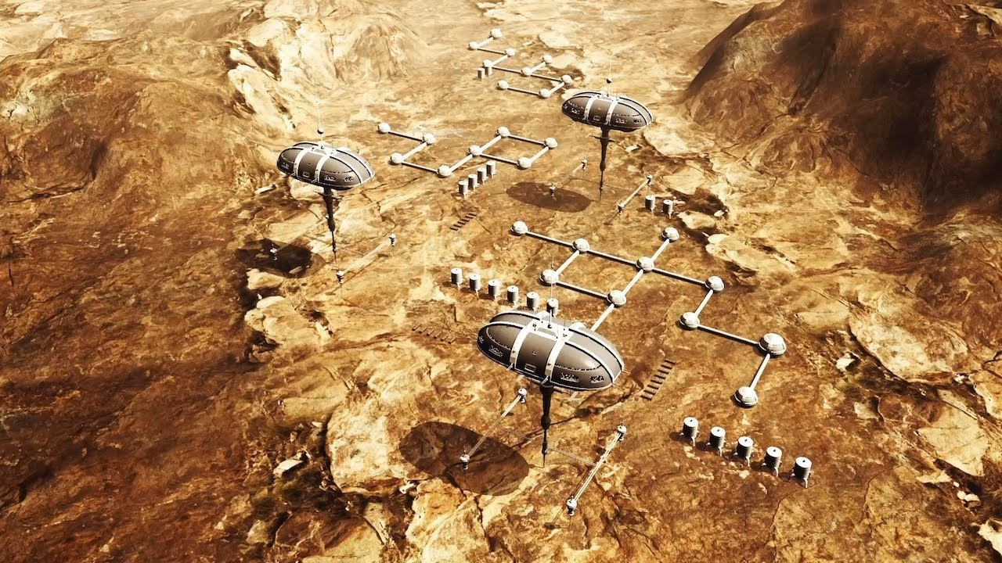
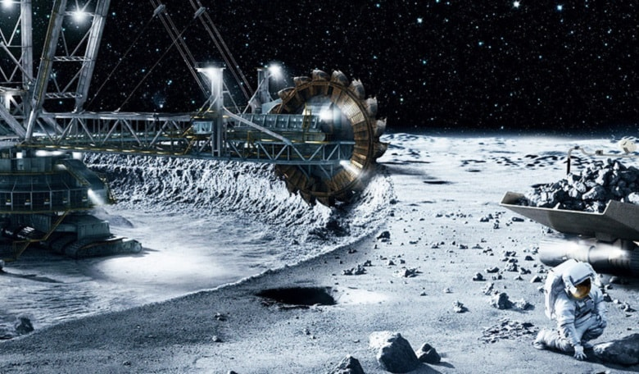
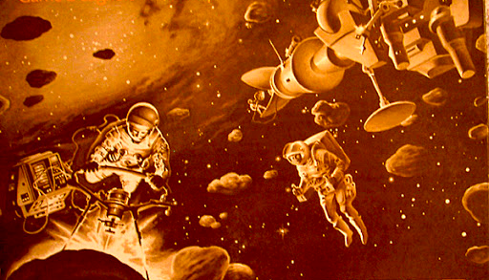
SPACE MINING
Notes:
Reusable space vehicles will lead to exponential reductions in the cost of transporting materials back from space.
Valuable commodities that are rare on earth can be mined in space in more ethical and in a more environmentally friendly manor.
Advanced manufacturing technologies such as 3-D printers will enable mining rigs and equipment to be constructed and repaired without returning home.
The abundance of material combined with the values back on Earth will enable provide economic incentives to private companies to pursue space mining and take on the risk.
Though there are many benefits to space mining there are also some serious impacts
Space-mined materials could devalue the price of current precious materials
Earthbound mining operations will likely see some reduction leading to a healthier environment and a reduction in dangerous working conditions.
The economic benefit of space mining will likely lead many private companies to lobby their home governments to protect their economic interests.
Government led Space based infrastructure will grow in order to support mining operations

Slide 7
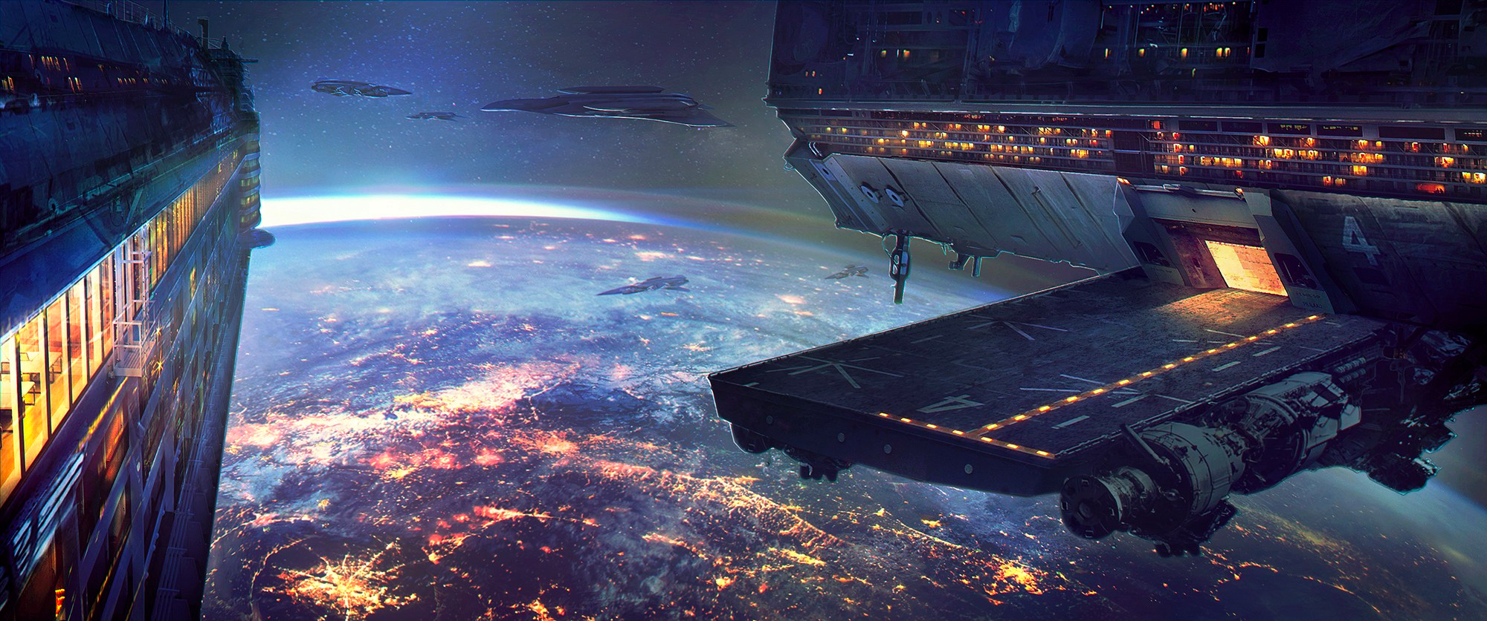
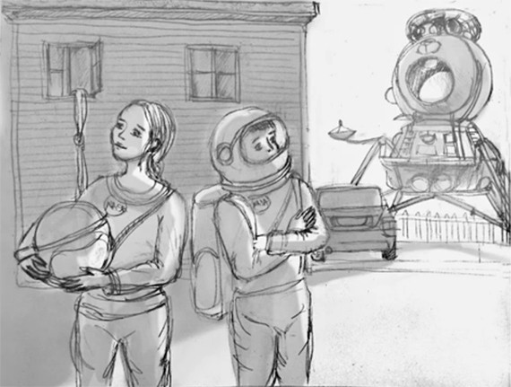
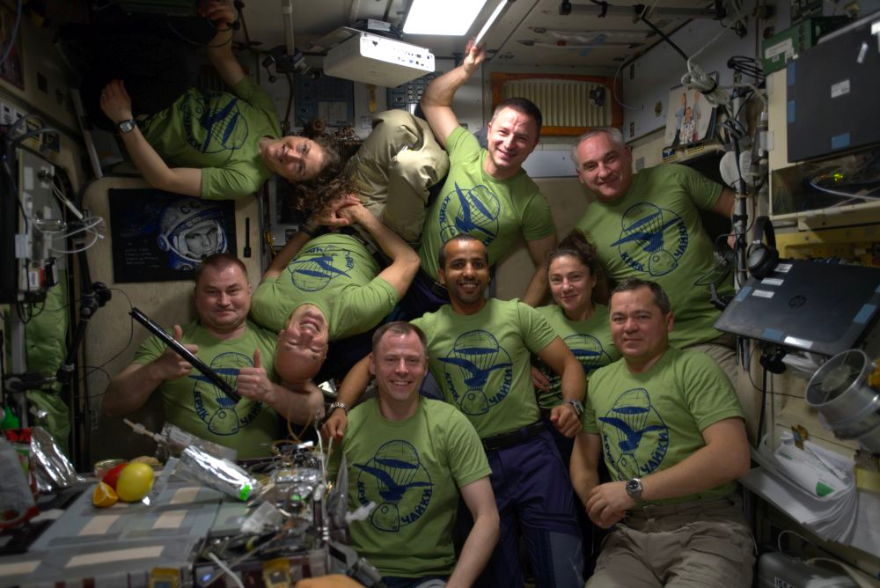
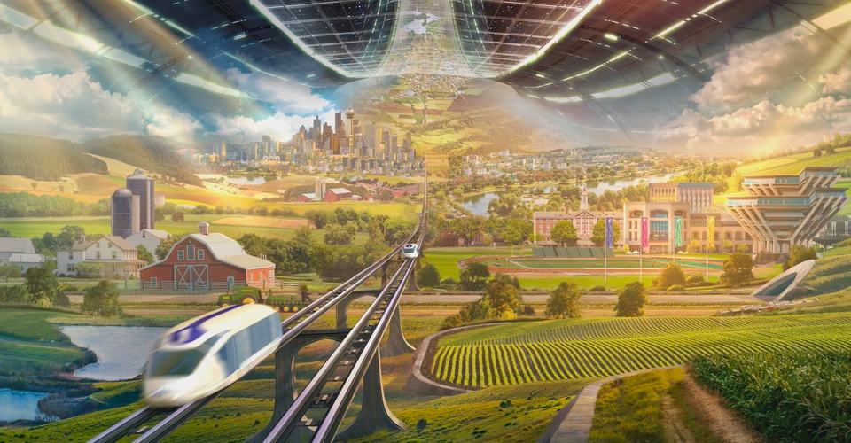
COLLABORATION – THE FUTURE IS GLOBAL
Notes:
As seen in the previous slides, the future of space involves leveraging technologies across industries and societies to truly reach for the stars.Gone are the days of nationalism and the “Space Race”. Society has thrived in Space and through the diverse perspectives and experiences across all cultures, innovation is at its peak. In the “Possible” of space, we find that the future is truly global.
First image:
We have reaped the fruits of labor from years of early space colonization. With the ISS a relic of the past, Spaceship like buildings now orbit the galaxy, offering a metropolitan view of space, with loading docks for reusable space vehicles going to and from earth on space mining efforts.These facilities are a versatile office space, providing accessibility to miners, as well as a training center to equip newcomers to space with the tools necessary for adaptability and survival in the extraterrestrial terrain.
Space is now multi generational. We’ve seen families born in space, young astronauts training and attending school with their peers, being considered a citizen of Mars and only a visitor to Earth. Families spend a majority of their time in space, and vacation to Earth and other planets occasionally, however the focus has been on orienting future generations to solve the complex problems of tomorrow, which include the environmental impacts of Space colonization from the mid 2000’s.
In Space, there are no country conflicts. With humans existing that have spent their entire lives in Space, individuals find less focus on allegiance to a specific country, and instead focus on betterment and equality of all members of society. Engineers, doctors, scientists, teachers and other professions work together, as seen here by the annual global space summit, a program that sends delegates from each colony in space to collaborate and learn from one another. This year’s summit explores the possibility of a pandemic in Space. Members explore and problem solve and use the past to learn and prepare for the future.
Space now has a fully developed infrastructure, with public transit moving Spacemen and women from rural areas to metropolitan locations for work and school. Utilizing renewable energy sources a major focus of the future of Space is addressing the food crisis that still prevails. Sustainable organic farming is performed in the fertile plains of Mars and exported back to earth and across the colonies of Mars and the galaxy. The space revolution is thriving, and we’re beginning to see the culmination of generations focused on empathy, equity, and innovation rise up.

Slide 8
“The future belongs to us. All we need to do is reach out and grasp it”
Notes:
Like all future domains, we can’t pursue the future of Space without challenging the status quo and understanding the WHY behind the signals around us. Reusable space vehicles, privatization of space flight, and legislation promoting Space exploration are all in existence today. If we can recognize these signals are a cluster of something much larger, the possibilities of the future are truly limitless.

Slide 9
Notes:
In summary, the future of space belongs to the curious.

