Slide 1
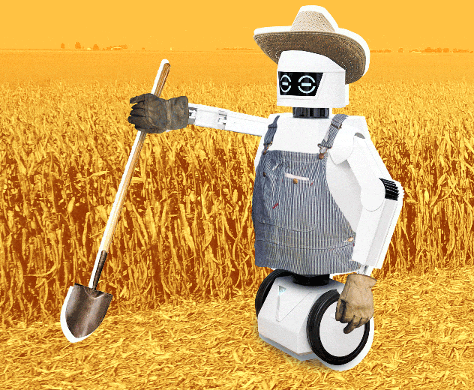
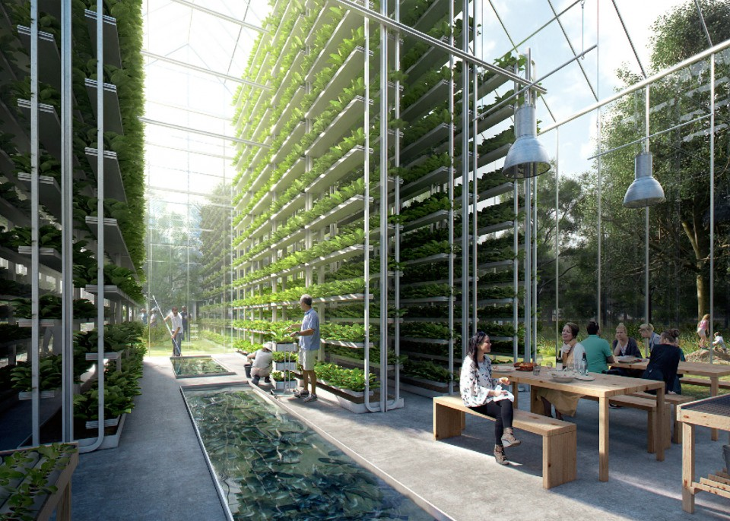
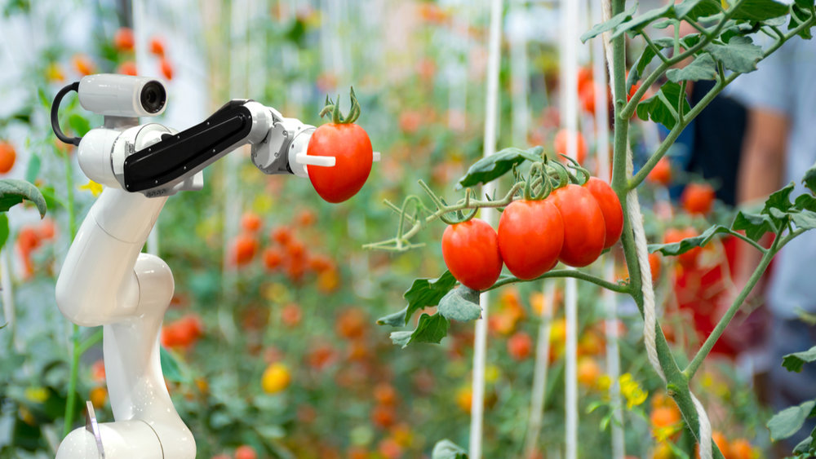
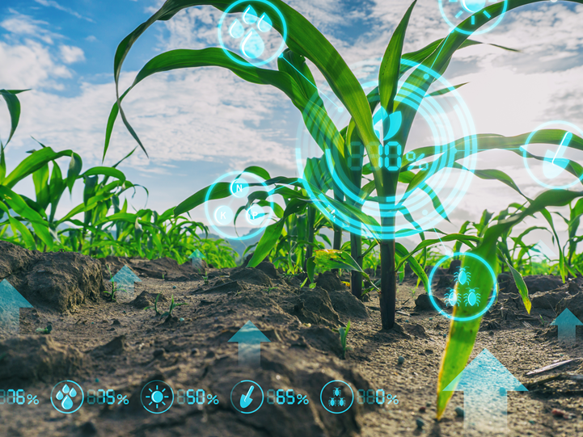
The Future of Food and Agriculture
Shreyas Bhatnagar, Ashley Delamater, Mustafa Ferozi, Helen Soloman
SMPP 6218 Strategic Foresight

Slide 2
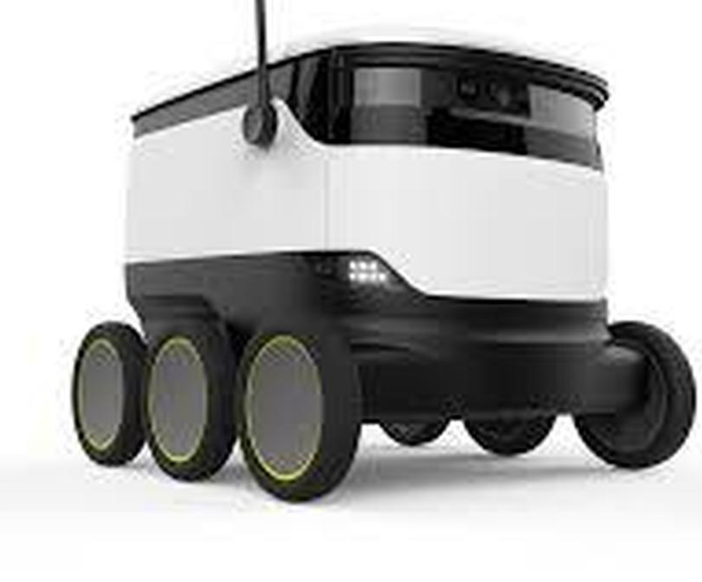
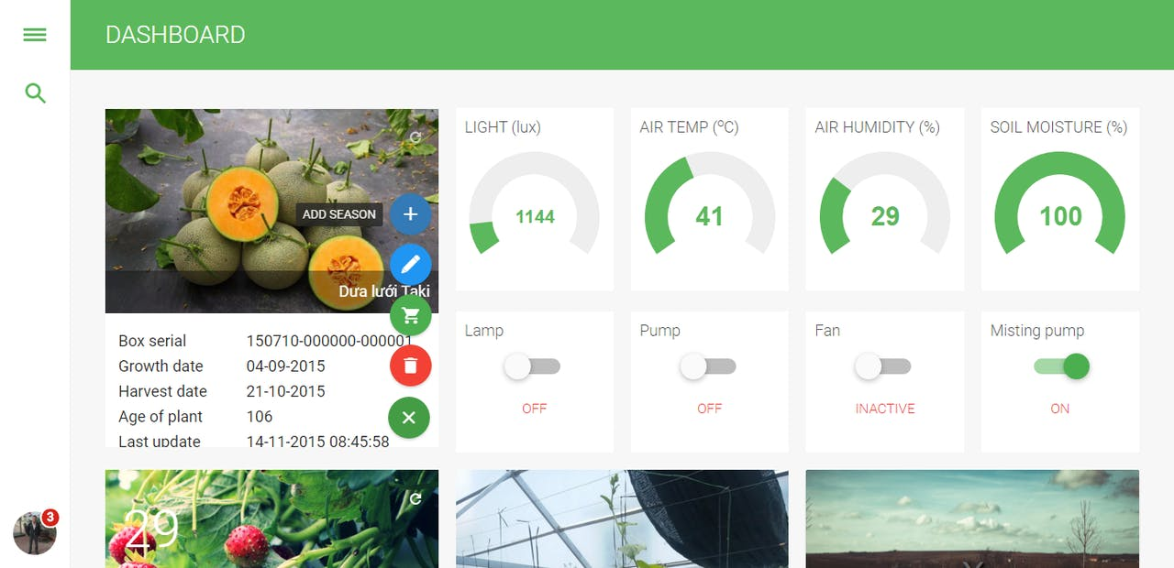
Fingertip Farming
Agriculture for the Modern Man
EARTH ALLIANCE

Slide 3
An Existential Challenge
Threats from Climate Change and Population Growth
Population Growth
Climate Change
Farming
9.7b
70%
$416b
Projected global population by 2050
Proportion of global water use by the agricultural sector
Farm debt in the United States as of 2019
70%
20%
3%
Increase in food production required to meet demand
Of the globe’s greenhouse gas emissions generated by agriculture
Decline in number of farms and ranches in the United States between 2012-2017
66%
Of the world expected to live in urban centers
No matter how out-of-control the climate system seems – with its roiling typhoons, unprecedented famines and heat waves, refugee crises and climate conflicts – we are all its authors. And still writing.
David Wallace Wells
Source: “Eating Our Way Out of The Climate Crisis,” Vantage, Institute for the Future, 2019, www.iftf.org; Salmon K, “The Future of Food,” Accenture, 2019; Semuels A, “Small American Farmers Are Nearing Extinction,” Time, 11/27/19; Daniels J, “Census of Agriculture shows continued decline in number of US farms,” CNBC, 4/11/2019.

Slide 4
Mapping the Fringe
Trend Factors: Gov, Politics, Media, Public Health, Demography
Meal Replacements
“Whole Foods” Fads
School Lunch Programs
Health Wearables
Diets
GMO
USDA
Food Pyramid
Food Insecurity
Monsanto
Obesity
Perdue
Dairy Lobby
Potato Lobby
Corn Lobby
Sugar Lobby
Keto, Paleo, Whole30, Fasting
Food Shortages
Food Deserts
Pesticides
Veganism/ Vegetarianism
Communities Around Farming
Gene Editing
Animal Rights Activists
Farm-to-Table
Convenience
Farmers
Animals
Food Delivery Services
Environmentalism
Future of Food & Ag
Restaurants
People Growing Own Food
Consumers
Grocers
Fast Food
Vending Machines
Environmentalist Groups
Climate Change
Automation
Whole Foods
Food Packaging
Food Waste & Recycling Services
Amazon
Companies Relying on Vending Machines
Robotics in Farming
Tesla
Vertical Farming
Trucking Industry
Lack of Food Education
Food Waste As Energy
Drones
Shipping Industry
Urban Farming
Impossible Burger
Beyond Meat
Advertising

Slide 5
An Automated, Urban, and Lab-Based Oligopoly
Evolution of Food and Agriculture
Probable (5-10 Years)
Wide-Spread Robotic Farming
Plausible (10-50 Years)
Transition to Local, Vertical Farming
Possible (50+ Years)
Lab-Grown Food Under A New Food Cartel
5-10 Years
10-50 Years
50+ Years

Slide 6
Probable: Wide-Spread Robotic Farming
5-10 Years into The Future
3 Classes of Innovation
Agriculture Technology (AgTech)
Represents the application of technology to the field of farming
Tech Assisted Farming
Plant/Soil Analytics
Sensors
Advanced Machinery
New Farming
Indoor and Vertical Farming
Revolutionary Farming
Clean Meats
Produce meat from animal cells

Slide 7
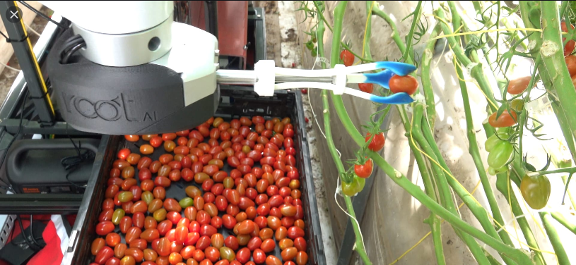
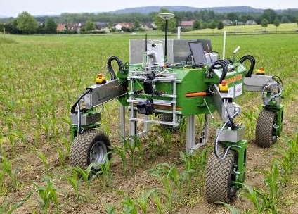
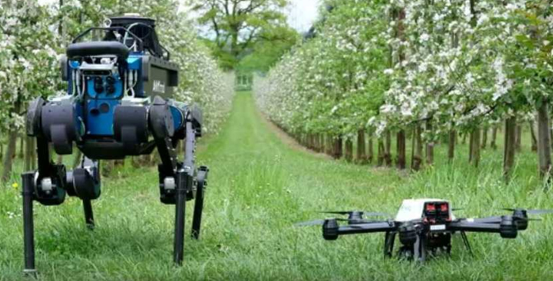
“A sustainable agriculture is one which depletes neither the people nor the land.”
Wendell Berry

Slide 8
Plausible: Transition to Local, Vertical Farming
10-50 Years into The Future
Urbanization
Localized Vertical Farming
Elevated Convenience Factor
Overpopulation
Office-based job force on the rise
Generational trends of Millennials and Generation Z
AeroFarms localizing the way we think about vertical farms
Willo’s launch in Jersey City and Walmart…?
“Direct-to -Consumer” model
No more shopping, personal growing, importing
Nutrient infused pills and meal replacement shakes

Slide 9
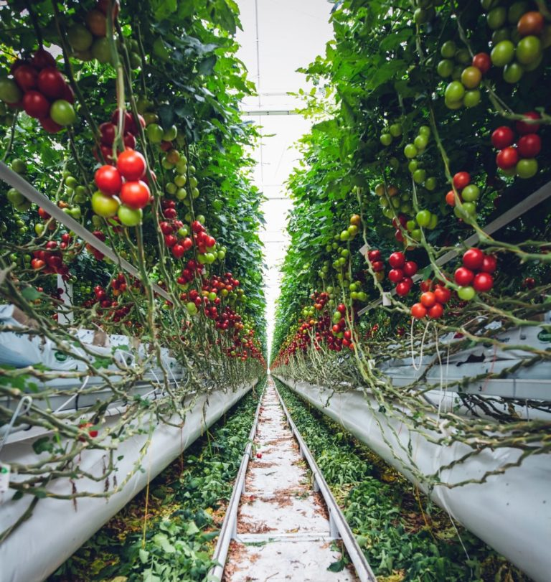
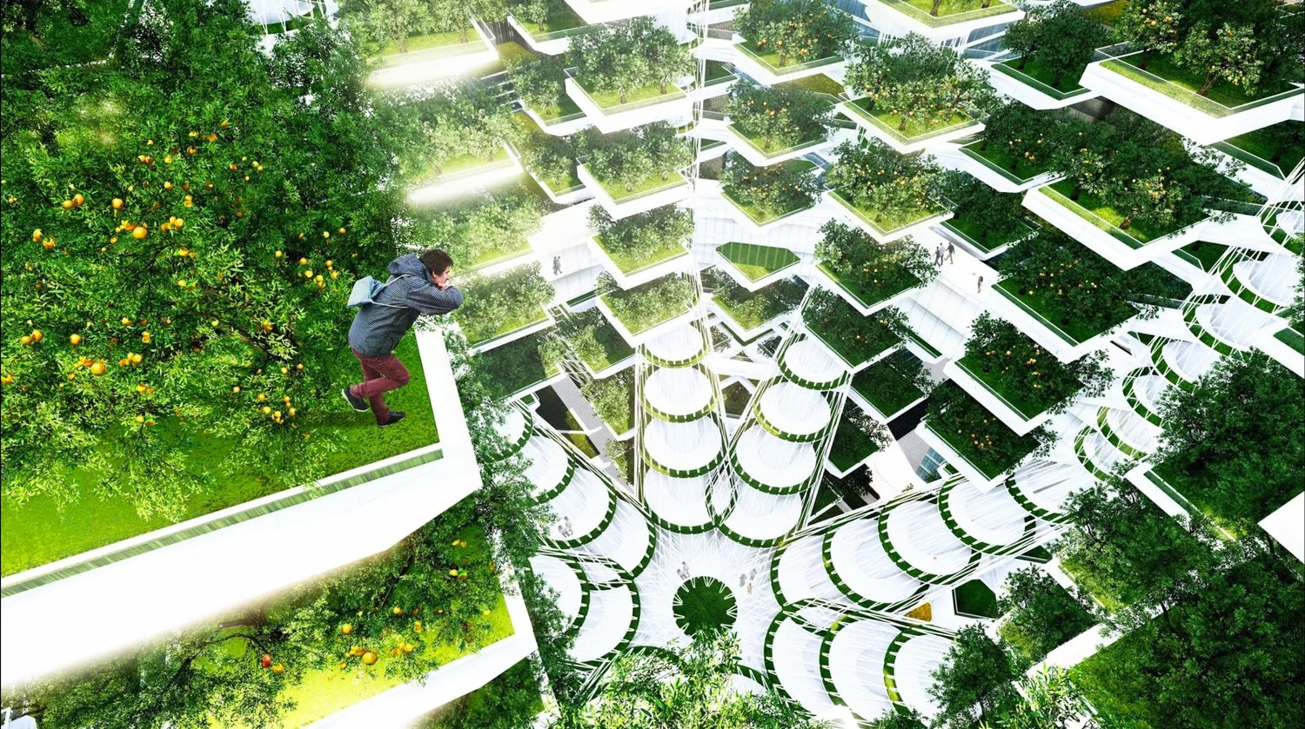
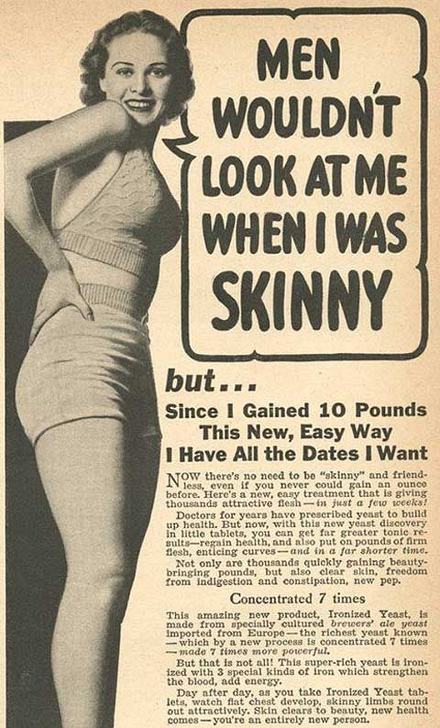
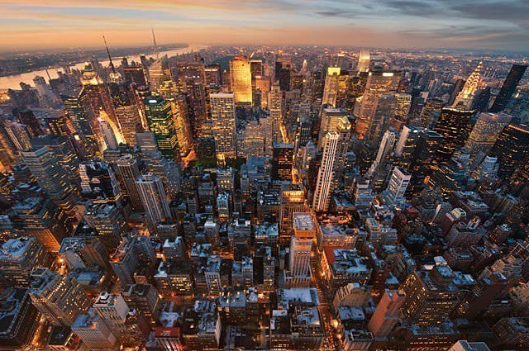

Slide 10
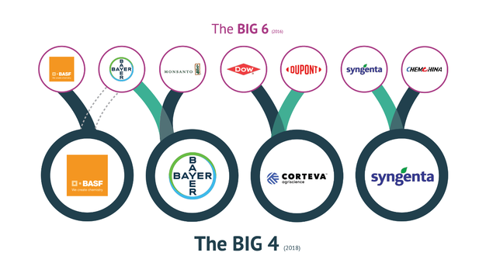
Possible: Lab-Grown Food Under A New Food Cartel
50+ Plus Years into The Future
Source: https://www.spurwingcomms.com/single-post/2018/12/10/The-%E2%80%98Big-6%E2%80%99-become-the-%E2%80%98Big-4%E2%80%99-how-will-agriculture-companies-communicate-to-differentiate-in-2019.

Slide 11
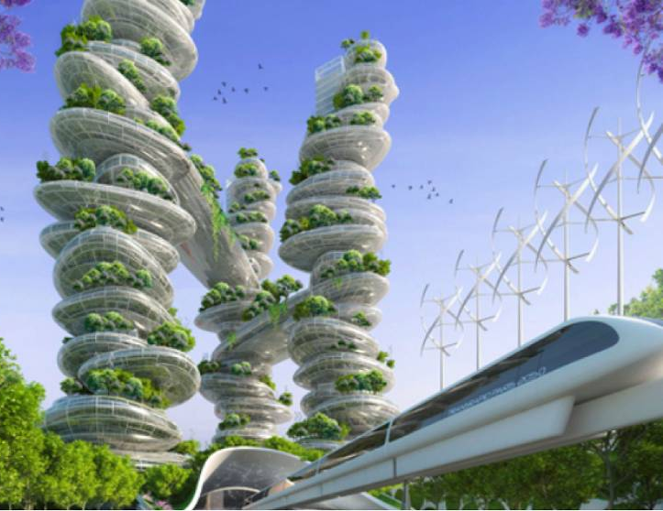
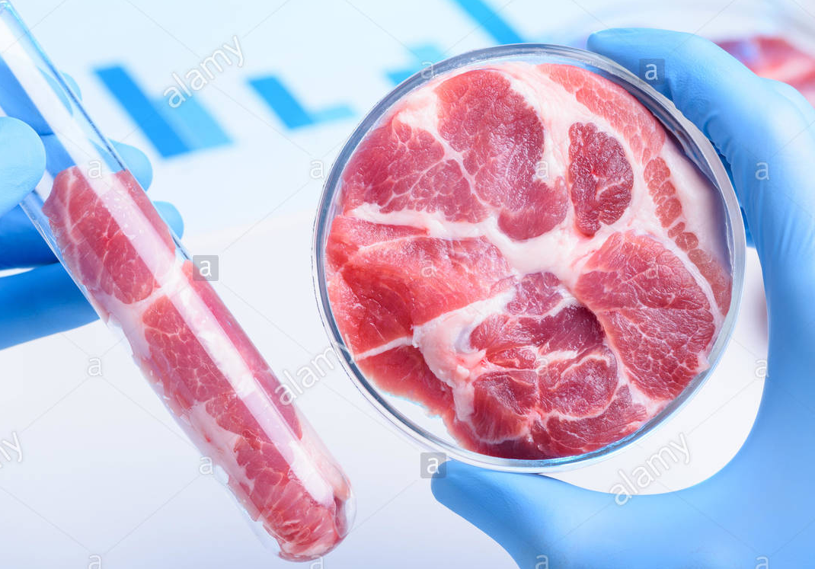
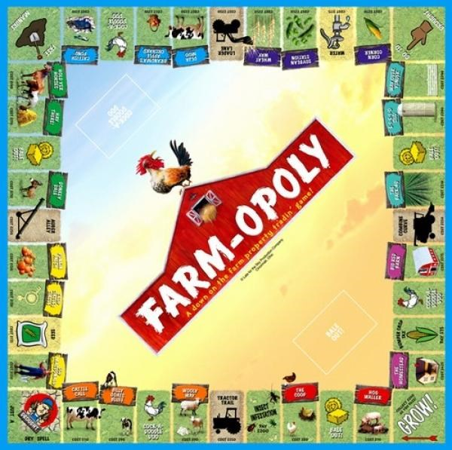

Slide 12
Fingertip Farming
Agriculture for the Modern Man
EARTH ALLIANCE

