Slide 1
Welcome to Education 2035
Kasey Chen
Cynthia Cook
Chris Lembesis
Natasha Ross

Slide 2
The Future of Education promises a bespoke experience delivered through a globalized, immersive platform ecosystem. With equal access for all.

Slide 3
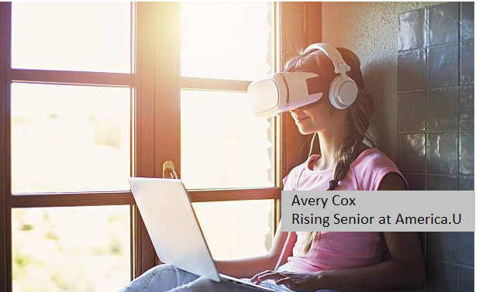
America.U Debuts Socrates.Ai
Fully holistic, immersive, educational ecosystem released for Fall 2035. Analytics-driven, Socrates.Ai promises to revolutionize the learning experience for students and educators alike.

Slide 4
Meet 19 year-old America.U student, Ace
Lives in Telluride, CO
Averages a B; actively working with professors across the country and advocates to boost academic performance
Requires medication to help with focus and ability to comprehend instruction
Reliance on medication is a burden
Demotivated and concerned about ability to sustain
Socrates.Ai - instrumental tool to Ace’s academic achievement
Customized, comprehensive educational and integrated platform
Provides enhanced experiential learning
Syncs with a biometric implant and detects lapses in attention
Instructs the implant to deliver appropriate dose of medicine

Slide 5
Team ED’s Process for Determining Education’s Future
Mapping the Fringe
CIPHER Analysis
Signals and Clustering
Probable, Plausible, Possible
Storyline and Persona
Idea formation on the future of education and the technological implications
Narrow the group’s brainstorming to identify signals on the fringe
Determine signals and cluster those signals to create alternative scenarios
Tie the scenarios to the Probable, Plausible, and Possible then estimate time zones
Create a persona and storyline that conveys the possible future in a powerful way

Slide 6
Signals
Recent political initiatives for creation of free post-secondary education for all. Post-pandemic questions resurgence on the extreme high cost of education and perceived value. Brick & Mortar version of higher education may be quickly turning obsolete.
Electroencephalography (EEG) is an electrophysiological monitoring method to record electrical activity of the brain, traditionally used in the medical setting. In fall 2019, schools in China began placing headsets with EEG sensors on student’s heads, tracking performance and focus. Analytical data available to teachers, student, and parents.
CES 2020 debut of Samsung Neon Artificial Humans interactive, realistic, and built to learn individual preferences and respond accordingly. Envisioned uses: customer service, athletics, TV personalities, or simply, a friend.
Debut of Microsoft Holoportation allows for real-time 3D capture and transmission.

Slide 7
PROBABLE
Post-pandemic resurgence of questions related to the extreme high cost of education and perceived value
Disappearance of brick and mortar educational institutions
Advocacy for free, nationalized public education and policies introduced
National public postsecondary education system America.U debuts in 2025
Socrates.Ai platform introduced in 2035
As a result, we create a more level playing field
Private education will still exist
Time zone: 1 - 10 years [near to mid-range]

Slide 8
PLAUSIBLE
Electroencephalography (EEP) is used to monitor student performance in class and assess focus, engagement, emotional state, and biomedical stats.
Student performance is presented visually through indicators on the headset and app, to queue professors and others about risk.
Data reporting is accessible by students and professors and administrators.
Faculty performance is rated and analyzed based on student performance data, which is then used to evaluate strength of faculty and curriculum.
Artificial Intelligence and avatars are used to deliver personalized teaching assistance. Those TAs can be called through voice assist devices and render through a tablet or life sized display.
Time zone: 10 - 20 years [long-range]

Slide 9
POSSIBLE
Instruction is delivered through holoportation - real time or throughout periods of history
Brick and Mortar and hybrid education is abandoned
Results in a highly immersive education instruction for higher education and graduate programs
Simulations and experiential based AR/VR learning include:
Time travel; conducting scientific experiments; international and intergalactic experiences; medical school rotations through “live” hands-on surgeries; robotics
Holoportation bodysuits are physiologically mapped and deliver sensory triggers and feelings
Time zone: 20 - 30 years [far range]

Slide 10
Thank you!
Questions?

