Slide 1
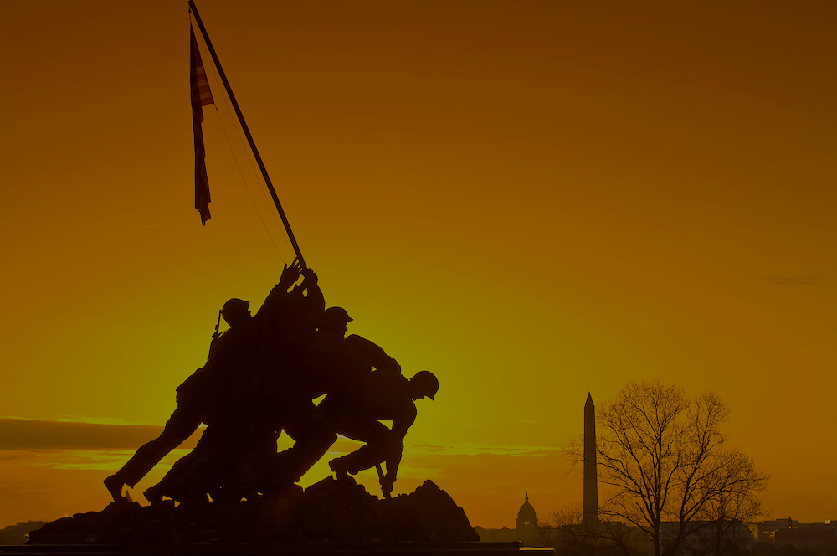
Vets Drive Vets
DC-Maryland-Virginia Demonstration project
August 2020

Slide 2
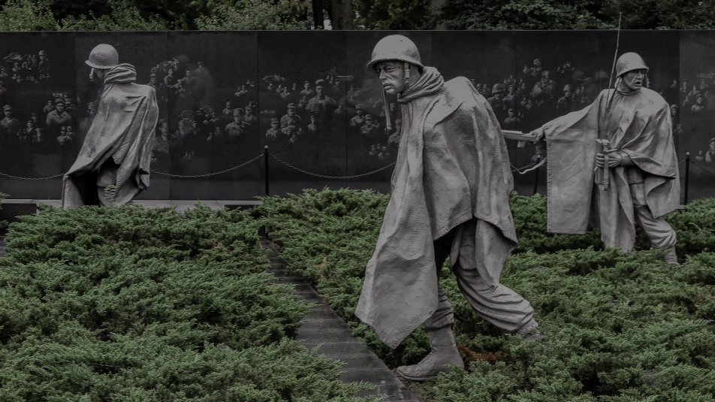
Who We Are.
VetsDriveVets is a George Washington University-based initiative. It is a coalition of partners and organizations with two common goals:
To serve the mobility needs of veterans.
To build entrepreneurship opportunities for veterans.

Slide 3
Vets Drive Vets Chapters.
VDV chapters are social impact funded companies that deliver heath care support services to local veterans.
Veterans start a for-profit mobility company in their community to provide flexible, health related services to other local-based veterans struggling with a lack of effective mobile services.

Slide 4
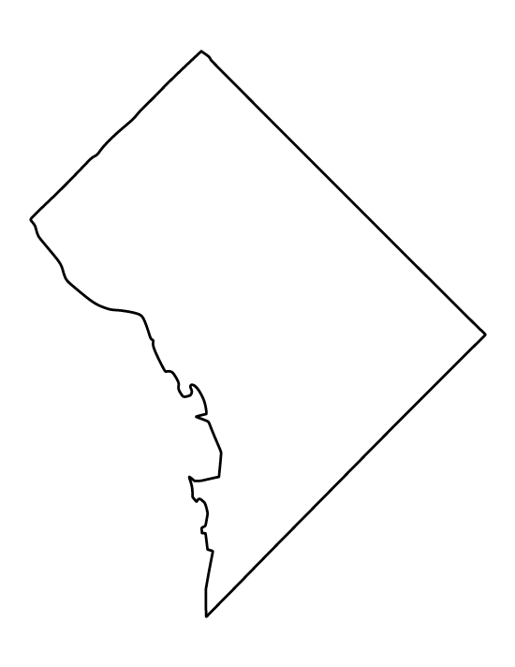
The DMV Demo project secures initial key infrastructure and operational processes to replicate across chapters.
Technology – Key technology, including dispatch software and data collection is developed through the pilot and provided to each VDV chapter.
Inclusive Mobility Community
DMV Pilot
Text
Dispatch and Delivery – Operational processes to ensure successful business operations of each chapter to be formalized through the pilot program.
Customer Discovery and Engagement – Establish processes for securing local partnerships in local veteran communities, care networks etc.
3
Notes:
INSERT A CHART THAT EXPLAINS VETS DRIVE VETS
Pilot, then spokes off the hub. Provision of vehicles for the plot
THREE BUCKETS OF PARTNER NEEDS:
Technology
Dispatch and delivery
Customer discovery and engagement

Slide 5
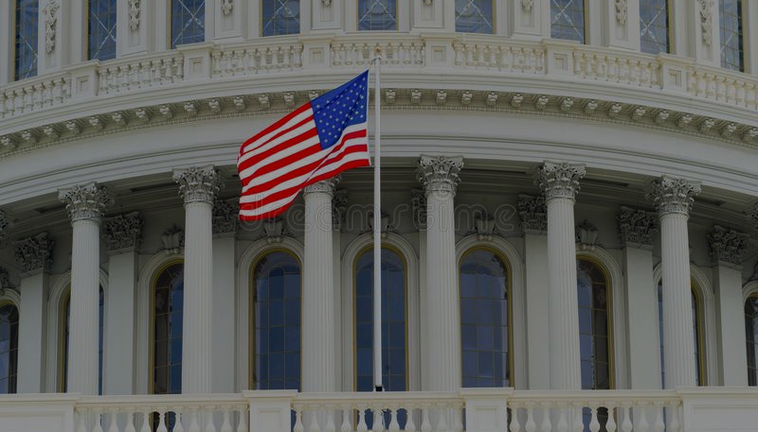
The DVDs Demo is a coalition of key partners focused on the success of each Vets Drive Vets Chapter.
Name | Role
John Forrer | Director, GW ICR (Co-Chair)
Seth Miller Gabriel | GW Alumni Partner
Peggy Tadej | Director of Military Affairs No. VA Regional Council (Co-Chair)
Jeremy Ebie | Founder and CEO Phoenix Infrastructure Group
Kathleen Harrington | GW Alumni Partner
Thomas Niemann | Former Global Social Sustainability Manager, Ford Motor Co.
Louis Tharp | Co-founder and Executive Director, Global Healthy Living Foundation
Charlene Consolacion | CEO Biig
Gabriella Malek | GW Alumni Partner
:
4
Notes:
INSERT A CHART THAT EXPLAINS VETS DRIVE VETS

Slide 6
Our Model.
Vets Drive Vets chapters are founded on a business model based on Adaptability & Partnerships.
We provide each Vets Drive Vets chapter with a unique suite of technologies installed in a fleet of vehicles to provide flexible mobility services to veterans in the service of providing access to health care and related services. Using the technology and data provided, the services will be continually adapted to better serve each veterans’ individual needs.
Partnerships with local hospitals, physical therapy offices, pharmacies and veterans’ organizations allow for a holistic approach to care.

Slide 7
Vets Drive Vets offers a wide range of adaptable services to serve the real needs of veterans.
Health Applications for Veterans
Extended Applications:
Post-hospital visit transport
Education services (after school programs)
Transport to government offices
Job training transport
Hospital Commercial deliveries
Industrial deliveries
Post-hospital visit transport
Occupational Therapy / Physical Therapy appointment transport
Mental health services appointment transport
COVID-19 safe urgent care rides
In-person telehealth virtual setup assistance
Community Health check-ins
Medicine delivery and pickup
Post-hospital care and needs
Mobile vaccinations
Temperature controlled medical items transport
Nutrition assistance and food delivery
Hotspot providing
Data Applications:
Feedback from Vets Drive Vets patients on continued health needs
Data on full range of patient health needs
Data on community health needs
Data on health procedure follow up for better overall care

Slide 8
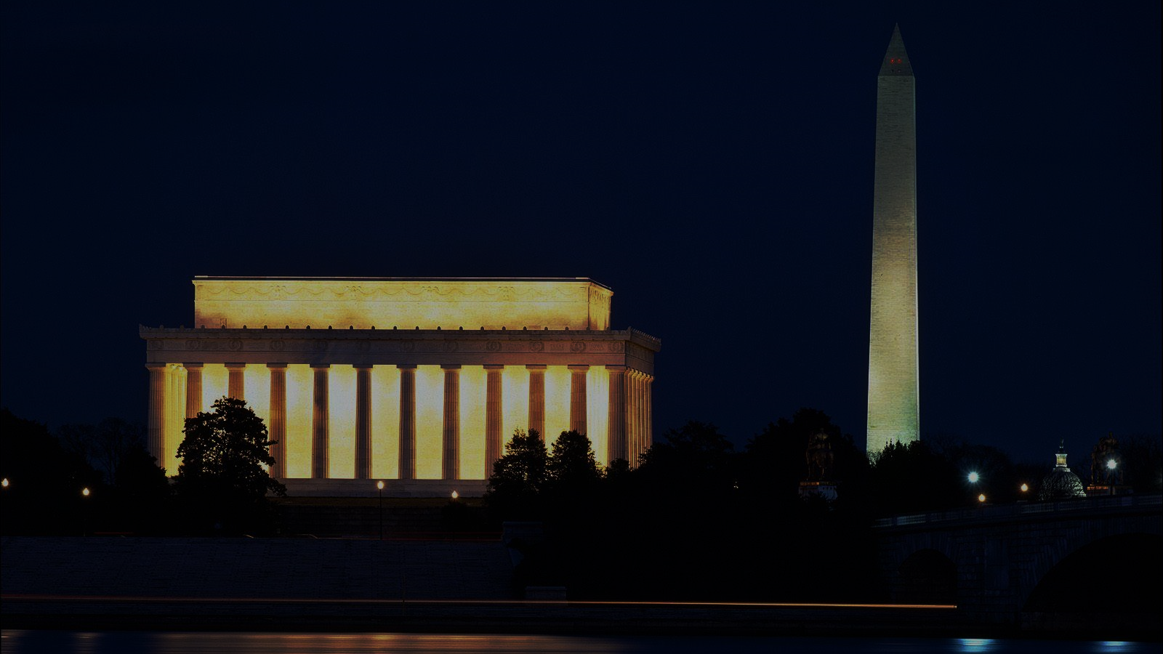
Social Impact.
Each Vets Drive Vets chapter is based on a principle of sustainable social impact.
Each Vets Drive Vets chapter will be both self-sustaining and profitable, while continually providing social impact to the veteran community.

Slide 9
Financing.
Vets Drive Vets is based on an action-based investment model.
Milestones drive the chapter funding, ensuring a strong incentive structure and overall success. As major action items are completed, the Veterans operating the Vets Drive Vets business earn more equity and funding for project growth.
An equity-based, action-oriented funding model ensures success for both the local Vets Drive Vets fleet company veteran-owner, and the investors.
Notes:
For investors
Need a new background without the watermark

Slide 10
We need you.
We are seeking initial investors to work and partner with us to launch the first DMV Chapter of the Vets Drive Vets enterprise. This Demonstration Project is scheduled to launch in Fall 2020.
With your help, we help veterans develop a successful business while having meaningful impact.

Slide 11
DMV Pilot Funding Needs.
The full pilot launch of the program in the DMV requires $500,000.
An investment in the pilot program secures:
Acquisition of a small fleet of vehicles for the DMV pilot.
Funds business operations for the VDV pilot fleet, including fuel, maintenance and operations.
Key business operations and management, including partnership development and management.
Development of sophisticated fleet management software and data collection software.
Technology systems integration and alignment.
Data collection systems, analysis and utilization.

Slide 12
Looking ahead.
The Vets Drive Vets DMV pilot will be the first of many VDV chapters. We aim to introduce the business and social impact funding models to cities around the globe.
A nationwide expansion of the Vets Drive Vets chapters will seek to alleviate a diverse range of social issues including education, health, nutrition and more by providing mobility services.

